Slide 1
TOPIC:
SOCIAL CLASS AND INEQUALITY

Slide 2
INTRODUCTION
Team Members:
Abdul Ahad Shaikh 20K-0319 (Introduction)
Ali Jodat 20K-0155 (Factors Contributing to Inequality)
Muhammad Basil Ali Khan 20K-0477 (Importance of classes)
Ali-uddin Khan 20K-1743 (Conclusion)

Slide 3
What is Class?
Class refers to a person’s economic position in a society, which is associated with the differences in income, wealth, and occupation.
For example, a wealthy/rich person is known as an upper class person. A less wealthy person is classified as middle class person, and a poor person with no money is classified as a lower class person.
Nowadays, people can define someone’s class by what their interests are.

Slide 4
What is Social inequality?
Social inequality occurs when there is an unequal distribution of resources in this society.
The three social inequalities that occur in most of the places in the world are racial inequality, gender inequality and wealth inequality.
However in Pakistan, the most occurring inequality is the wealth inequality, where the inequality gap is 52.6 %.

Slide 5
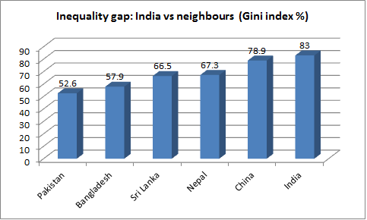
Inequality gap in comparison to other countries
However comparing the percentage with other Asian countries, the inequality gap is the lowest among all other Asian countries.

Slide 6
Talking about Racial Inequality
Racial inequality is when people are judged according to their race, or physical traits such as their skin color.
Racial inequality occurs the most in united states, for example The American health care system is filled with inequalities that have a negative impact on people of color. These inequalities contribute to gaps in health insurance coverage, uneven access to services, and poorer health outcomes among certain populations.

Slide 7
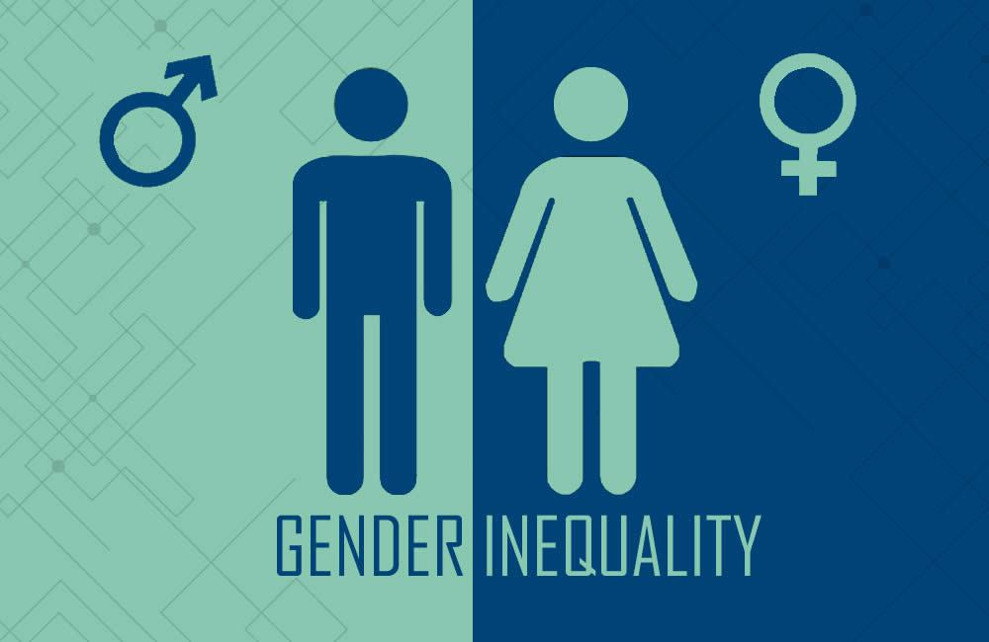
Gender Inequality
Gender inequality is the unequal treatment of a person on the basis of their gender. For example, access to education. In Pakistan, 71% of males are educated, where as only 47% of females are educated.

Slide 8
CAUSES OF POVERTY AND INEQUALITY

Slide 9
WHAT ACTUALLY THE CAUSE OF SOCIAL INEQUALITY IS.....

Slide 10
Multiple Education systems
Educational Inequality
Private and Public Schooling
Many different schooling systems (Madrassahs, government schools, English-medium schools, cadet schools and colleges, O- and A- level schools, the Aga Khan University board, government colleges and public and private universities)
Pakistan's government/public education system is not good enough
Investigative analysis had showed that drastic situation of education and poverty is greatly attributed to income inequality in country.
Officials in the education department say there are 2,800 government schools in Karachi. While there are about 6,000 registered private schools.

Slide 11
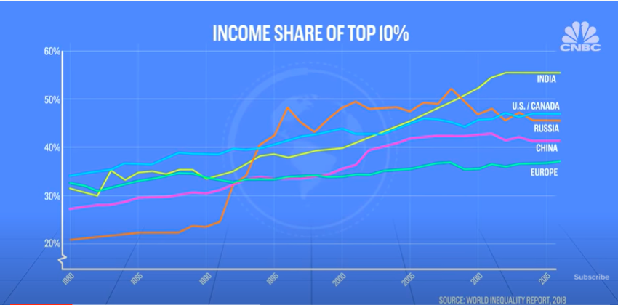
Income inequality
Income inequality is how unevenly income is distributed throughout a population
Workers are paid different on the bases of their gender, race, geographical location and occupation
Hiring's are also based on these above factors
Farmers, labors and other hard workers are not paid enough compared to the hard work they do

Slide 12
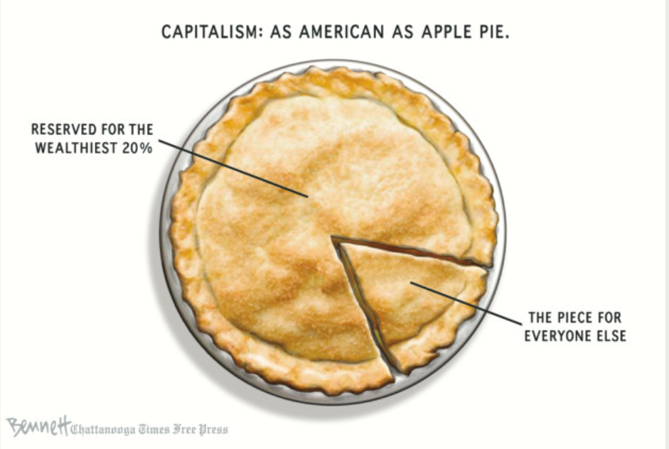

Slide 13
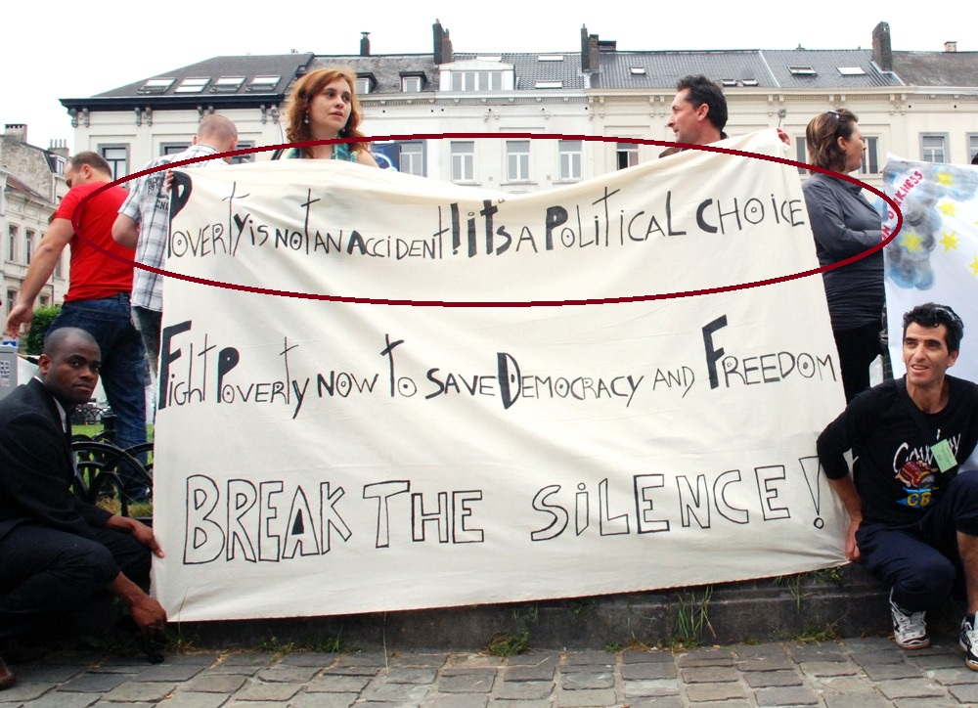

Slide 14
inadequate allocation of resource
No proper health care (e.g. in Baluchistan)
No Educational opportunities for poor
No modern skills taught in rural areas
According to UNICEF Pakistan had second highest percentage of out of school children I.e 44%
Government spending in luxuries instead of basic necessities for instance the project of metro buses in Islamabad costs approx. of Rs30 billion.
Relatives preferred for jobs rather than talent

Slide 15
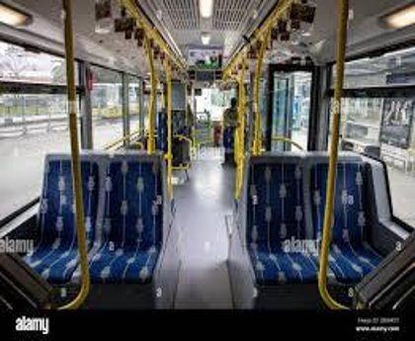
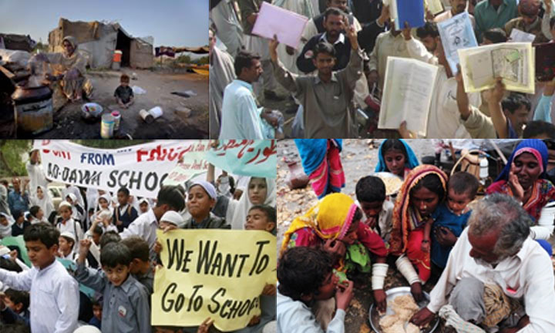
INADEQUATE ALLOCATION OF RESOURCE
Vacant Metro Buses
No Schools

Slide 16
Poor TAXATION SYSTEM
Depiction of taxation :
Welfare
To draw out wealth from Bourgeoisie
Work for proletariat(working class)
Reality :
Elite class find ways to escape taxation or pay minimum taxes
Working/Middle class burdened to pay taxes

Slide 17

Impact OF CLASS AND INEQUALITY
A social class affects how you live and how you die.

Slide 18
Impact of social class inequality
Each individual division of social class may impact
Health
Family Life
Education
Criminal Justice System
All impacts are somehow connected or linked with poverty/wealth.
Giddens (1998) - “There are few spheres in social life left untouched by class differences.”

Slide 19
HEALTH AND SOCIAL CLASSES
A person’s social class has a significant impact on their physical health, their ability to receive adequate medical care and nutrition, and their life expectancy.
Mortality and disease rates vary with class.
UPPER CLASS | WORKING / LOWER CLASS
Full time job | Part time jobs
More wealth | Less wealth
More health care services and life insurances provided by organization working for. | Less or no services as they are not full employed.
Take care of health, takes health diet and join different gyms to stay health, in short spend wealth on themselves | Much harder to take care of health, they cant take the time off work to go to doctor or take rest or join gyms to stay fit and healthy.

Slide 20
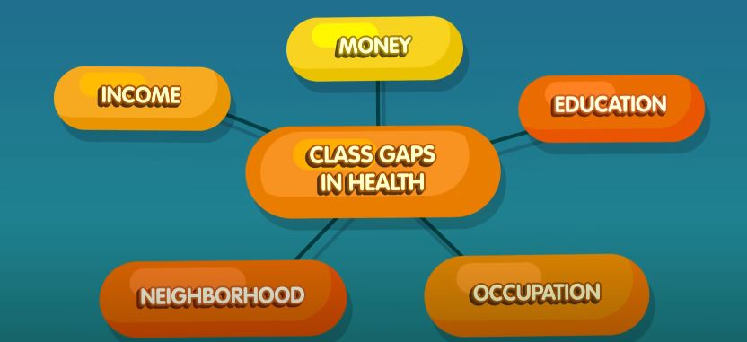

Slide 21
FAMILY LIFE AND SOCIAL CLASS
Family life including marriages, and household are strongly influenced by social class.
Different approaches of parenting can differ with classes.
An American sociologist, Annette Lareau, found in her parenting styles, wrote in her book “101 ways to get your kid to eat Broccoli ”.
In 1990’s, her research focused on observing families of school student from upper class to working class backgrounds.
In US, survey 1995, the first marriage ending is higher for couples having low socioeconomic status than middle..

Slide 22
EDUCATION AND SOCIAL CLASS
Educational inequality is one factor that keeps alive the concept of class division across generations.
Education is a major component of social class, both directly and indirectly.
Education can be “the Great Equalizer”.
Upper class prefers to send their children to private schools because of better faculty, technology, extra-curricular activities, and better educational facilities.
Lower or working class cannot afford the expenses of private schools so they have to send their children to government/public schools.
The number of out-of-school children in Pakistan is the 2nd highest in the world.

Slide 23
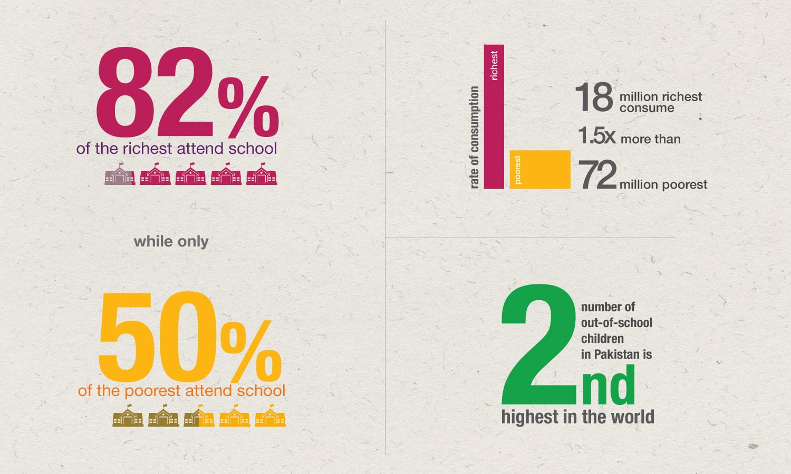

Slide 24
Judicial system and social class
Criminal justice is the system of practices and institutions of governments directed at preventing and justifying crime.
A recent survey in the U.S. revealed that more than 70 percent of the households that belonged to a lower class, had been involved in eviction cases, labor law cases, and other civil legal disputes and more than 80 percent of those cases lacked efficient legal representation.
Rich people are less likely to be caught and convicted of crimes, however, even if they are caught, they are able to bribe the justice system and let them go without investigation
In Pakistan, an example is the VIP culture, due to which the justice system is inclined towards the rich and powerful and the masses continue to suffer.

Slide 25
TLINE WHAT COULD BE DONE TO ERADICATE THESE CONSEQUENCES OF SOCIAL INEQUALITY
IMPORTANCE OF SOCIAL CLASS
POINT OF VIEWS
CONCLUSION

Slide 26
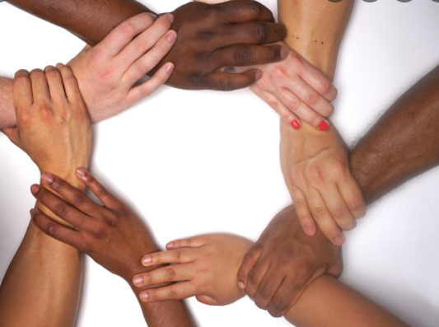
Removal of Racial INEQUALITY
Racial inequality identifies the social inequality even in a chess why white always prefer over black? Racial inequality is an American tradition. Relative to whites, blacks earn twenty-four percent less, live five fewer years, and are six times more likely to be incarcerated on a given day..
An incident of George Floyd who has been killed by U.S officers left the world with emerging questions. After that incident Argentina, Colombia, Ireland, Mexico, South Africa, Spain and Turkey enacted laws prohibiting racial profiling and racial discrimination.
On Geneva, Presenting the report, Kamran Michael, Minister for Rights of Pakistan, said that Pakistan was fully committed to the elimination of all forms of discrimination, and continued to uphold and implement the provisions of the Convention. Pakistan had recently adopted a National Action Plan on gender Rights, and racial discrimination to law enforcement personnel and the judiciary.

Slide 27
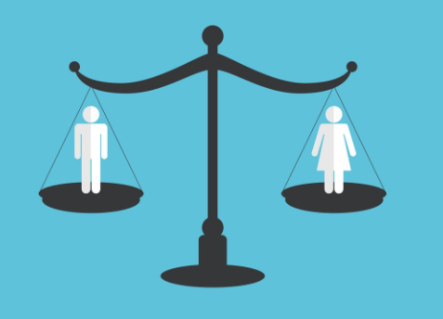
Removal of Gender inequality
Pakistan is having gender inequality due to unemployment ,health issues, uneven access to education and lack of political representation.
For the removal of gender inequality Pakistan has adopted a number of key international commitments to gender equality and women's human rights – the Universal Declaration of Human Rights, Beijing Platform for Action, the Convention on the Elimination of all forms of Discrimination Against Women, and the Sustainable Development Goals.
Moreover Pakistan has committed to meet the MDGs and Convention for Elimination of all forms of Discrimination Against Women (UNCEDAW). For reducing gender inequality, discrimination against women and their disempowerment, Pakistan has been implementing the Convention for the last 15 years.

Slide 28
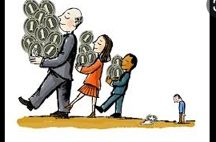
Removal of Resources inequality
Resources inequality include unequal distribution of income it also killing meritrocracy in our society.
There are many problems associated with unequal distribution of resources here are a few: Slow development, Poverty, Corruption, Human Migration, Low GDP, lack of economic and social justice. When resources are concentrated in the hands of a few people, then only they develop.
For the removal of this government have set up funds for the people. The Government of Pakistan launched the Benazir Income Support Program to reduce poverty and promote equitable distribution of wealth especially for the deserving peoples.
Imran khan also established EHSAS PROGRAM which aims for eliminating discrimination, poverty, and inequality from the society and capitalizes on utilizing the human resources .

Slide 29
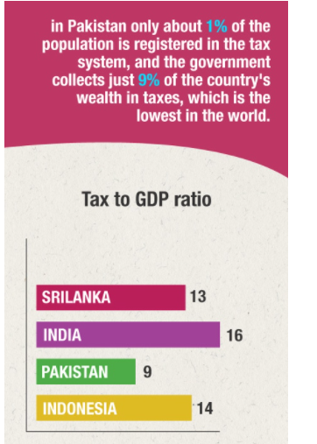
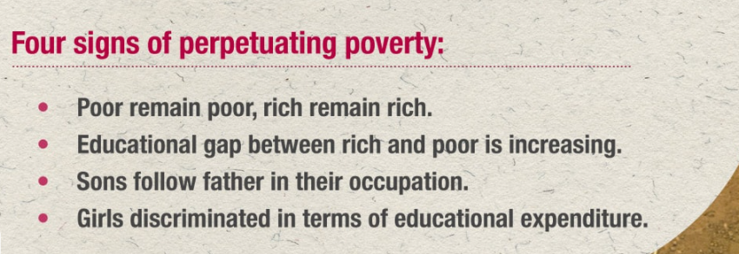

Slide 30
POINT OF VIEW
In my point of view this kind of all problems are because of corruption, greedy and selfish nature. We are living in greedy world man feels no respect on earth without money that is why he is trying to earn more and more money by good or bad means. Greedy and corrupt mafia is generating these ignoble type problems. It's important to urge how we got to this stage, the answer is very simple, political failure. Politics in Pakistan is the first area which should be cleaned up, otherwise the cycle will keep repeating.
Everyone wants a “Naya" Pakistan. Many dream it to be a Dubai-lookalike - a perfect mix of east and west; others wish it to be more orderly like Singapore, where littering, spitting, urinating anywhere but in a toilet are offences and come with a penalty. Ironically when it comes to the gnawing gap between the rich and poor, there is a resigned indifference.
Few Pakistanis ever say they want a Pakistan where everyone should have access to justice and adequate nutrition, clean drinking water, enough food for their families, quality education and healthcare. A Pakistan where political participation and power is shared between the rich and poor regardless of gender, class or religion and most importantly where wealth is not concentrated in the hands of a handful.

Slide 31
Importance of social class
Social classes provide their members with distinctive sub-cultures that prepare them for specialized functions in society. It is said that the social class is useful as an efficient means of role allocation in the society. Without it society is unbalanced as said by sociologist that If someone born poor they can become rich by the efforts and the work and also if someone born rich they can died as poor too.

Slide 32
Inequality is fully justified if it is not systematic

Slide 33
SOURCES AND REFERENCES:
https://courses.lumenlearning.com/boundless-sociology/chapter/the-impacts-of-social-class/
https://www.youtube.com/watch?v=0a21mndoORE
https://www.theatlantic.com/health/archive/2012/02/explaining-annette-lareau-or-why-parenting-style-ensures-inequality/253156/
https://www.dawn.com/news/1178703
http://criminal-justice.iresearchnet.com/crime/social-class-and-crime/

